Slide 1
WELCOME
Notes:
We are Alabama Liquid Snake and we would like to welcome you all to our fourth Capstone Project demo.

Slide 2
By 2020,
85%
of all customer interactions will be handled without a human agent
Invespcro.com
Notes:
According to a study conducted by invespcro.com, by 2020, 85% of all customer interactions will be handled without a human agent.

Slide 3
Phishing attempts have grown
65%
in the past year
Retruster.com
Notes:
Another study by Restruster.com indicates that the number of reported phishing scams has increased by 65%.

Slide 4
Customers don’t know
where
their private information is going or
who
has access to it
Notes:
These two statistics begin to paint a picture that leads to one concerning conclusion: customers are unaware of the streams through which their private information is transported and who can access those streams. As soon as they submit their data through a web form, it is forever available somewhere in cyberspace. What happens if private data such as identification numbers, banking details or even passwords are submitted? What if there was a way to warn a user that they are at risk of transmitting private data, or even block them from doing so?

Slide 5
B O T I C
the privacy aware chatbot
Notes:
Introducing Botic, the privacy aware chatbot.

Slide 6



What is Botic?
!
Notes:
In a day-to-day exchange between a user and an AI-based chat interface, the user will send through data which is received by the bot regardless of its content. This leaves people vulnerable to passing through information that they may not be aware is compromising, which is more common in users who are less tech savvy.

Slide 7
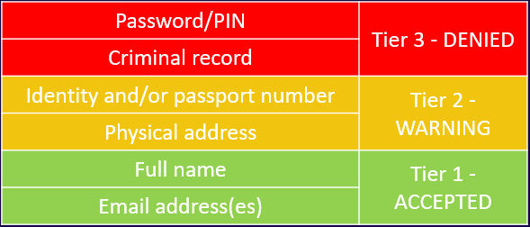
What is Botic?
✓
!
Notes:
This is where our system comes in. Before sending data through to the chatbot, Botic evaluates the user’s input and classifies it based on a severity index. If the information is flagged as being a potential confidentiality breach, the user will be warned and advised to edit the content of their message, with recommendations that vary based on the evaluated severity………..

Slide 8
What is Botic?
✓
Notes:
If no risk is detected, Botic gives the user’s message the go-ahead to be transmitted to the chatbot.

Slide 9
Core Functionalities
Private information scraping and classification
Customer support neural network ticketing system
Proprietary response digest
Client representative response suite
Notes:
We have four core functionalities for our system. The first is Botic itself, a private information detection and classification AI. To handle the user requests once the data has sanitized, we have a neural network chatbot that uses a client specific response digest to prevent cross contamination of information between companies. Lastly, if the AI’s certainty of how to handle a request is below a specific threshold, it will forward the message through to a client representative who will have a reponse suite that allows them to provide the relevant information that will be sent through to an email address provided by the user.

Slide 10
Most Impressive Aspect
AI ALGORITHM
Notes:
We believe that the most impressive aspect of this project is our Artificial Intelligence algorithm.

Slide 11
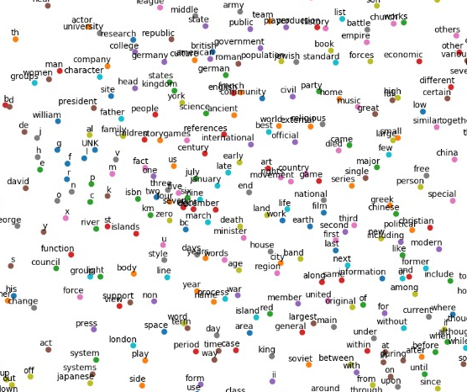
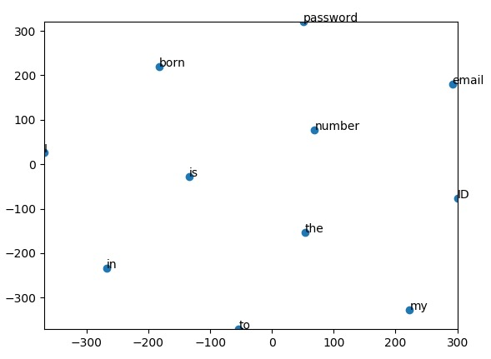
Most Impressive Aspect

Slide 12
DEMO

Slide 13
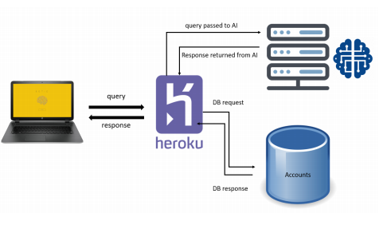
Deployment Diagram

Slide 14
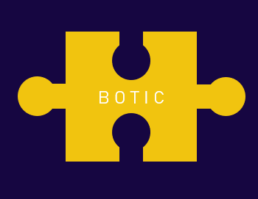
B O T I C
B O N U S
Notes:
As an additional section of our presentation, we wanted to show you the potential that our project has.

Slide 15
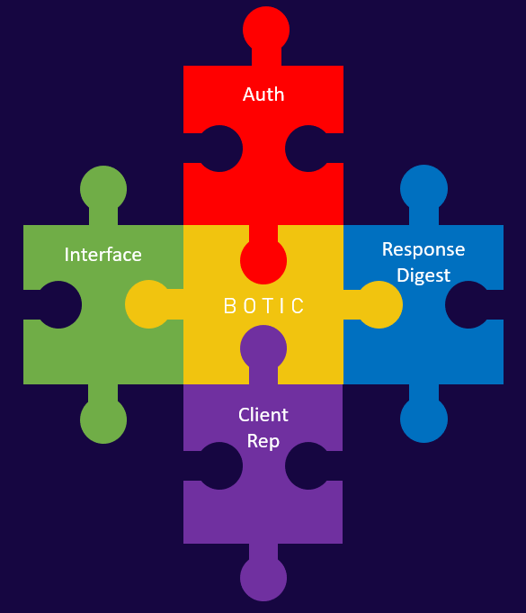
Notes:
As harsh as that seems, it allowed us to create a system that is so loosely coupled, it has become entirely modular.

Slide 16



Notes:
Whether it is used to prevent private information being leaked on social media.

Slide 17
Current Position
Start
Notes:
Before we move on, we would just like to give you all an idea of how far we are in our project and the challenges we have faced getting to this point. Most of us had worked with one another in the mini-project and so we all settled into our roles shortly after the start of the project.

Slide 18
Current Position
Start
D1
Documentation
(COS 214 & 301)
Notes:
Leading up to Demo 1, our primary concern was being able to deliver on not only the documentation due for the demo itself, but also to create a culture within our team of constantly updating it as we went along.

Slide 19
Current Position
AI design
(COS 212, 314 & WTW 124)
Start
D1
D2
Documentation
(COS 214 & 301)
Notes:
As Demo 2 came around, we were struggling to nail down the details of how our AI would work, more specifically, how we could detect passwords. We reached out to our client for some guidance and they provided some very valuable insight which would prove to be the key to us solving the problem.

Slide 20
Current Position
AI design
(COS 212, 314 & WTW 124)
Start
D1
D2
D3
Documentation
(COS 214 & 301)
Systems Integration (COS 216)
Notes:
We felt that we really hit our stride in the work period before Demo 3. Productivity was high and we were highly effective as a team. We had learned each others’ strengths and weaknesses which helped us to more effectively allocate and complete work. Our primary challenge was getting all of our subsystems to work together.

Slide 21
Current Position
AI design
(COS 212, 314 & WTW 124)
Time
Start
D1
D2
D3
D4
Documentation
(COS 214 & 301)
Systems Integration (COS 216)
Notes:
As I mentioned, by the last demo we had hit our stride. Going into this demo we were working well together but our main issue was time. To solve this, we came in during the holidays, public holidays and a few Saturdays as well. In fact we’ve seen Stacey on campus a couple times.

Slide 22



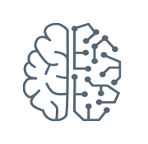
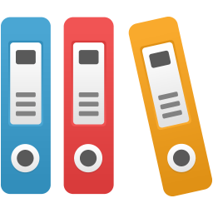
What’s Left?
User Interface
Documentation
Security
Learning on the Fly
Notes:
So what’s left for us to do? From this point we would like to focus on three main aspects of our project, before handing it over to our client. Firstly, we will be cleaning up the user interface to improve the user experience. We will be tightening up security to ensure a safe and trustworthy system. Lastly, we would like to continue to maintain and improve our documentation to ensure that the client has the best possible resources related to its functionality.

Slide 23
Questions?

